Slide 1

Currency Note detection for Blind Assistance using DL Final Year Project Presentation Department of Computer Science Govt Ank Degree College Haripur Presented By M.Adil Saeed (CS 21406) | Maalik Ashtar (CS 21418)

Slide 2
Table of Content:
Introduction
Problem Statement
Objectives
Development Methodology
Future Work
System Architecture
Results

Slide 3
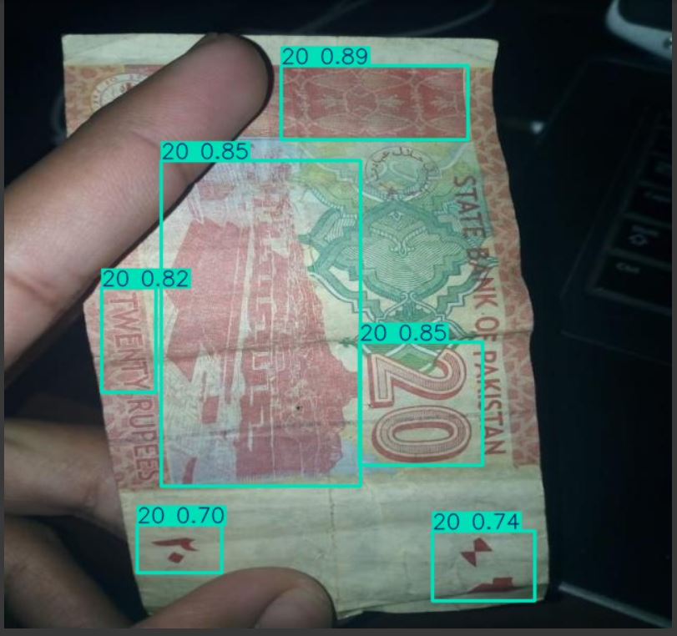
Introduction
In our project, we leverage the power of YOLOv5, a state-of-the-art object detection model, to accurately identify the Pakistani currency note. By training the model on a custom dataset of currency images, this system aims to provide a fast, reliable, and scalable solution for recognizing notes.

Slide 4
Problem Statement
Manual currency detection is difficult for blind people.
Existing systems struggle with real-time accuracy in different conditions.
Most systems lack offline voice control and audio feedback for blind users.

Slide 5
Objectives
To detect different Pakistani currency notes accurately.
To offer an instant text-to-speech (TTS) output that announces the value of the detected currency.
To ensure functionality for users without the need for capturing images.
To provide a user-friendly interface that facilitates quick access to currency identification features.

Slide 6
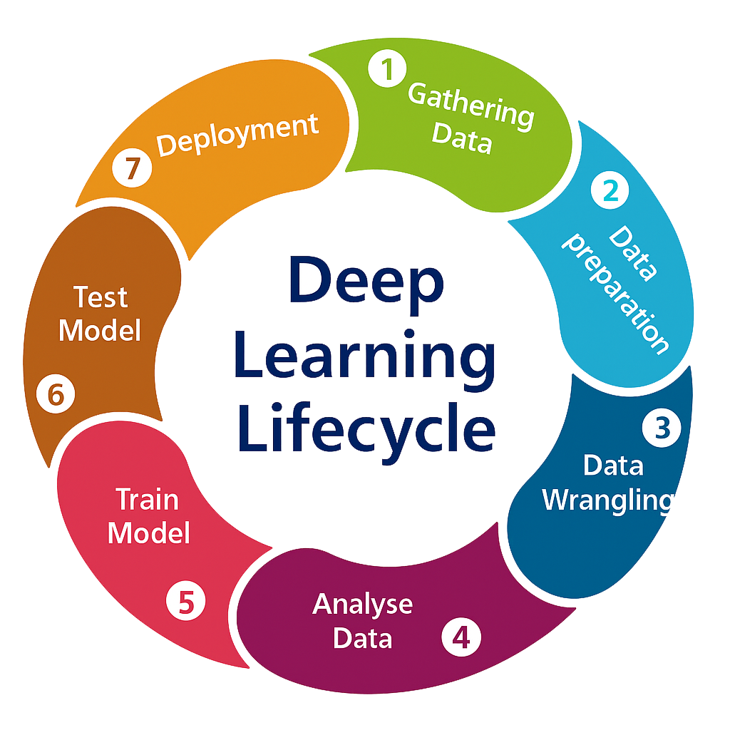
Development Methodology
This YOLOv5-based currency detection project follows a structured deep learning lifecycle. First, a dataset of Pakistani currency notes was collected and annotated. After cleaning and augmenting the data, exploratory analysis ensured balanced class distribution. The YOLOv5 model was trained with fine-tuned hyperparameters and evaluated using precision, recall, F1-score, and mAP. Finally, the model was deployed in a real-time desktop application with offline support and Text-to-Speech (TTS) for accessibility.

Slide 7

Development Tools & Language
YOLOv5
Python
Google Colab pro
Roboflow
Text to Speech Engine
Visual Studio Code
Vosk(Speech Recognition Tool)

Slide 8
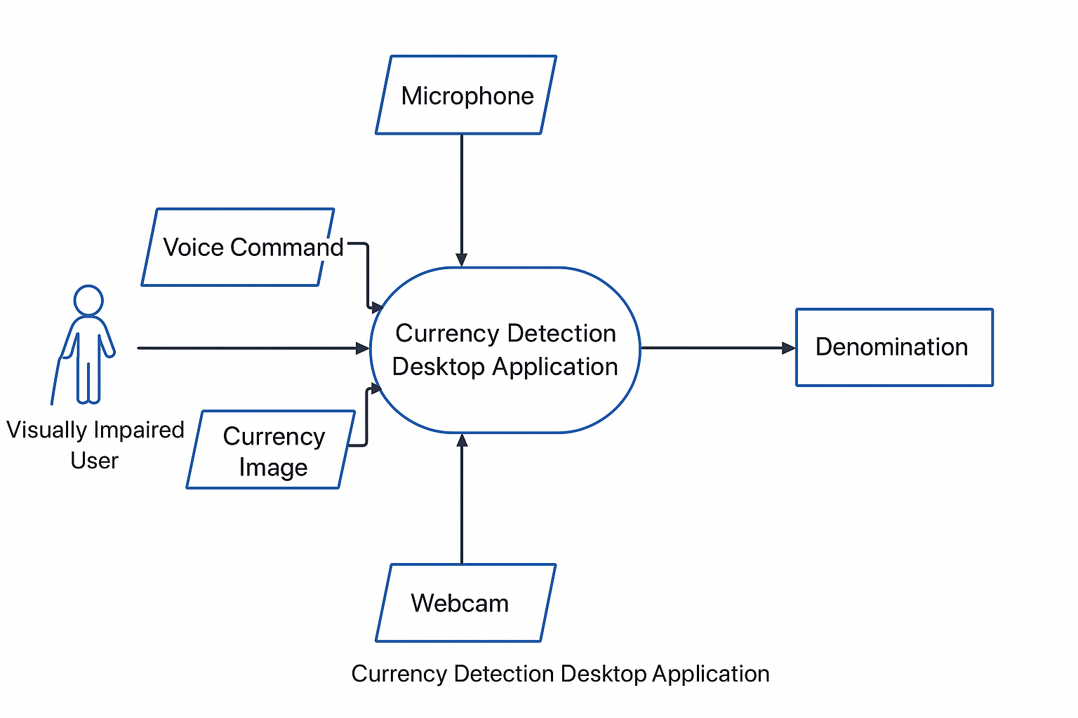
System Architecture
Use case diagram

Slide 9
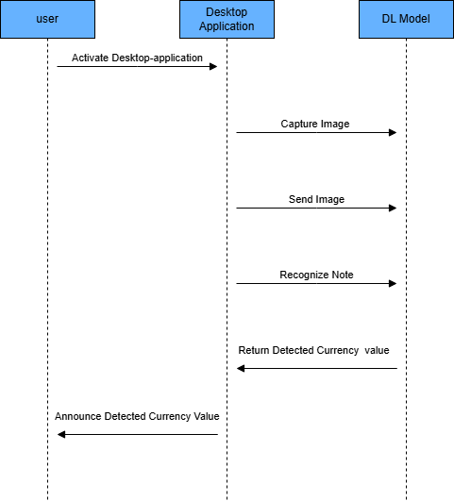
Sequence Diagram

Slide 10
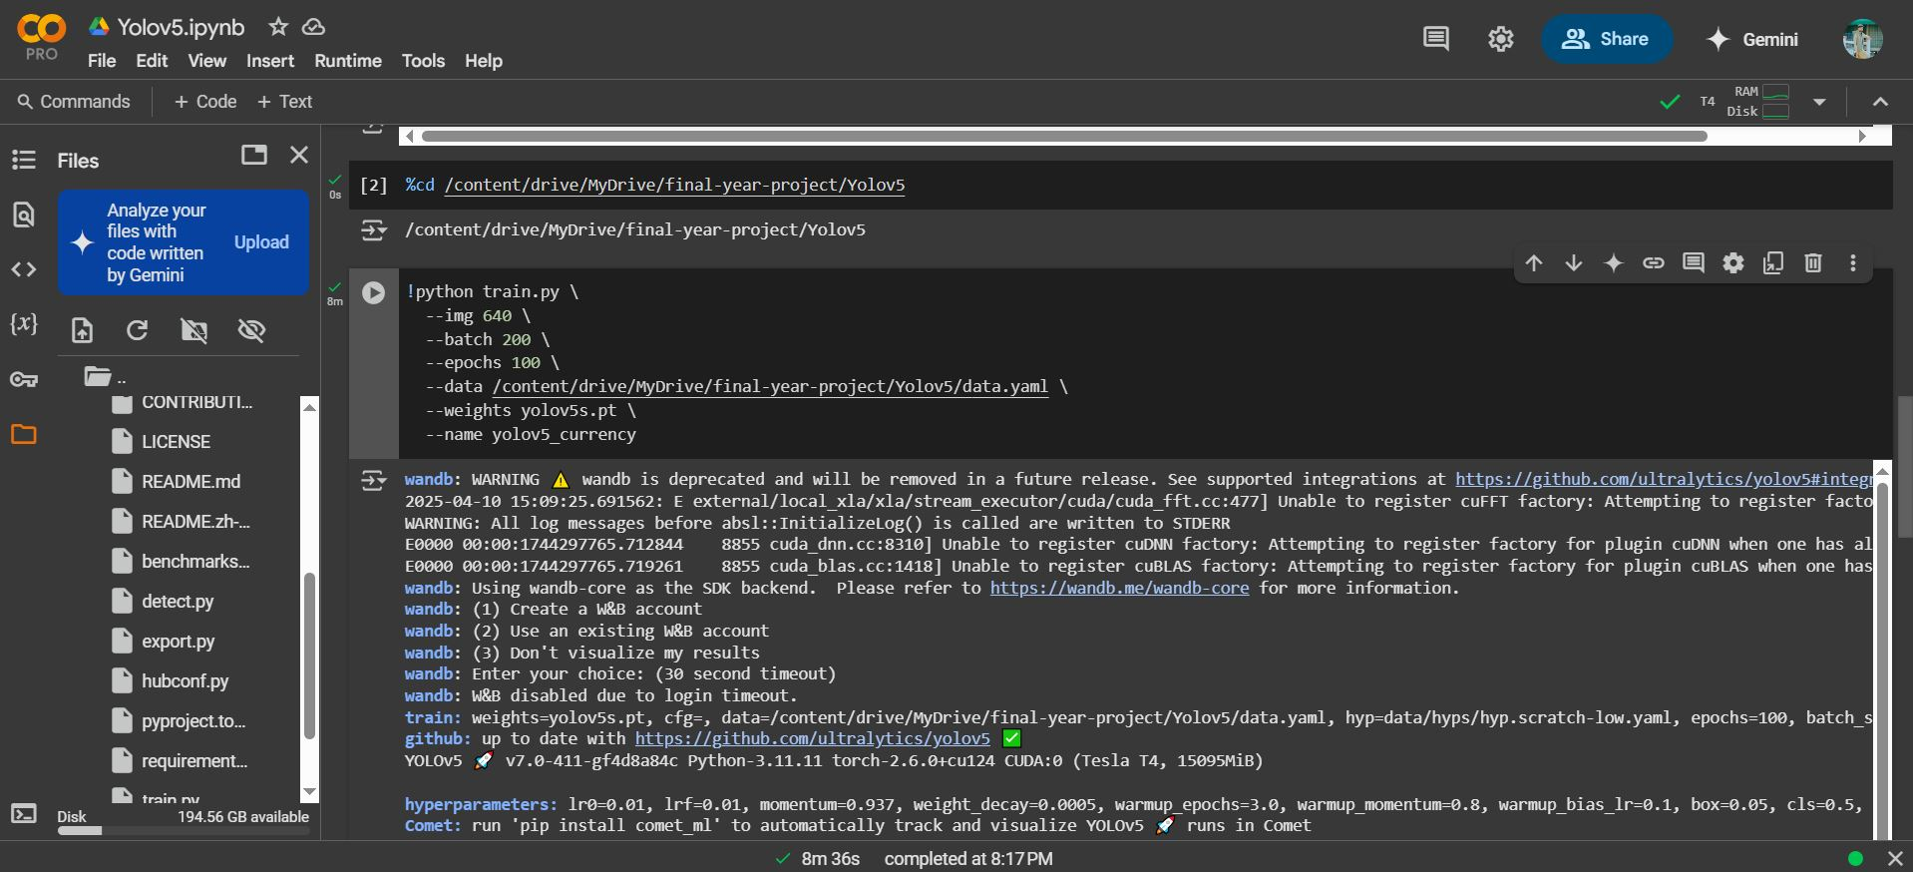
Training yolov5 Model

Slide 11
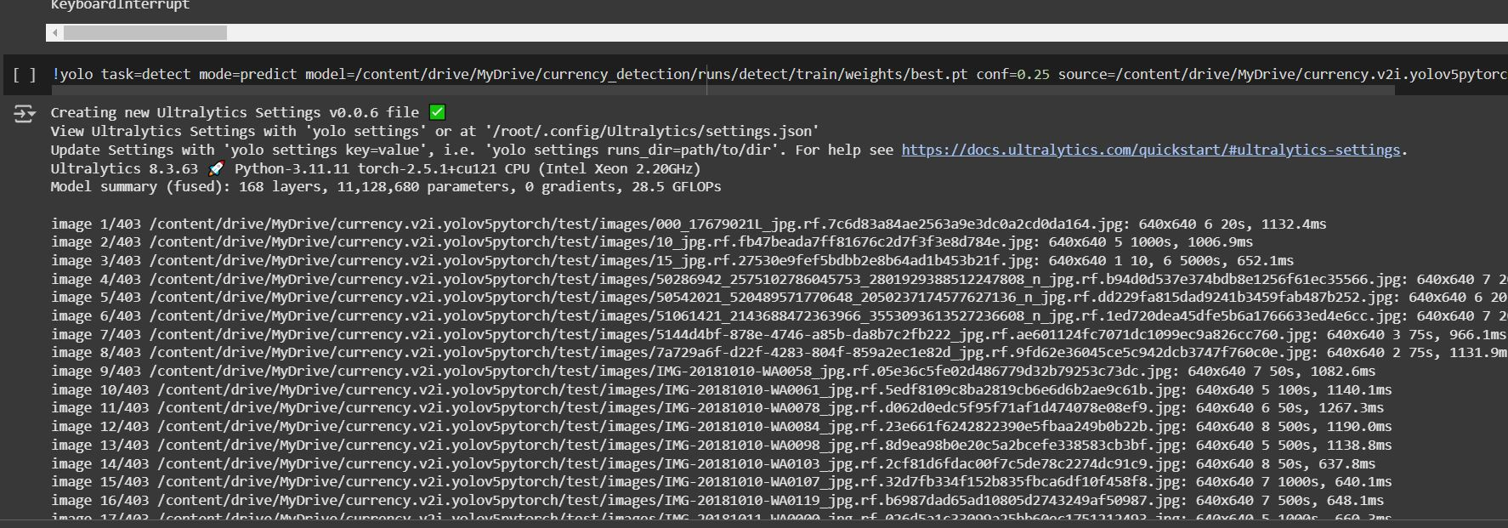
Testing the model

Slide 12
Results

Slide 13
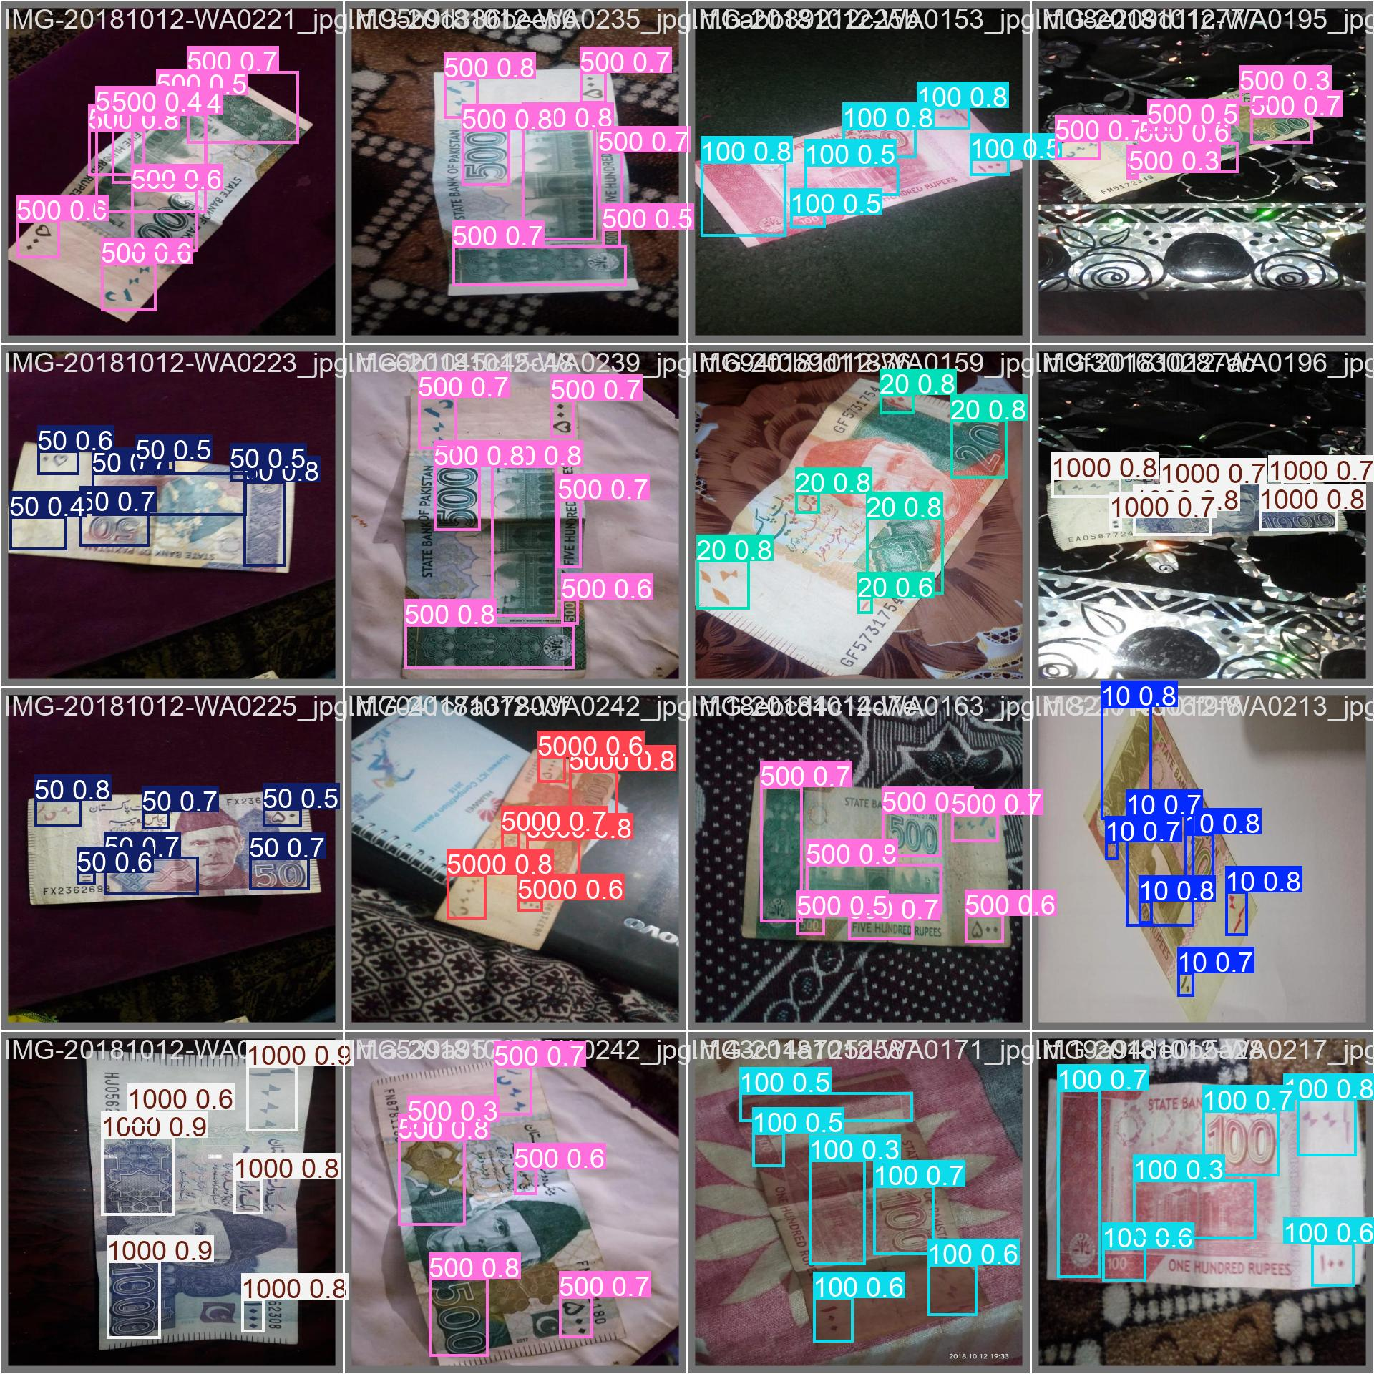

Slide 14
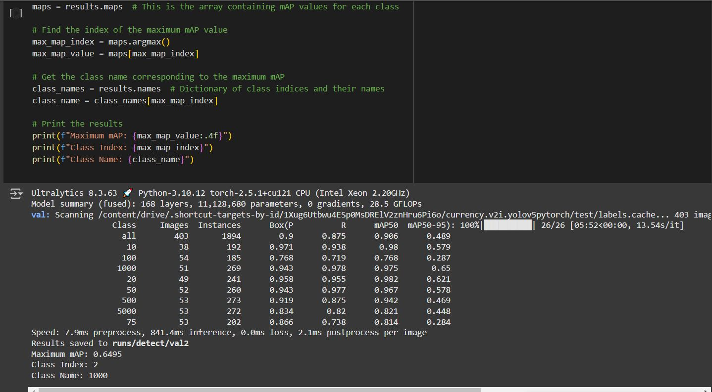
Accuracy of model

Slide 15
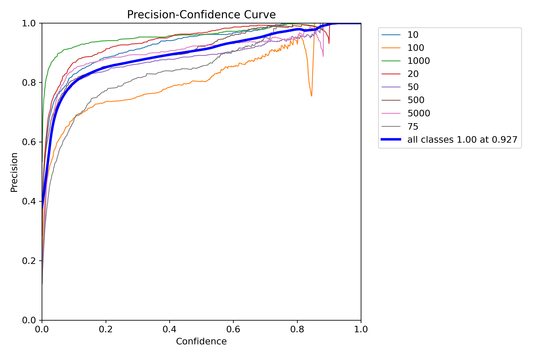

Slide 16
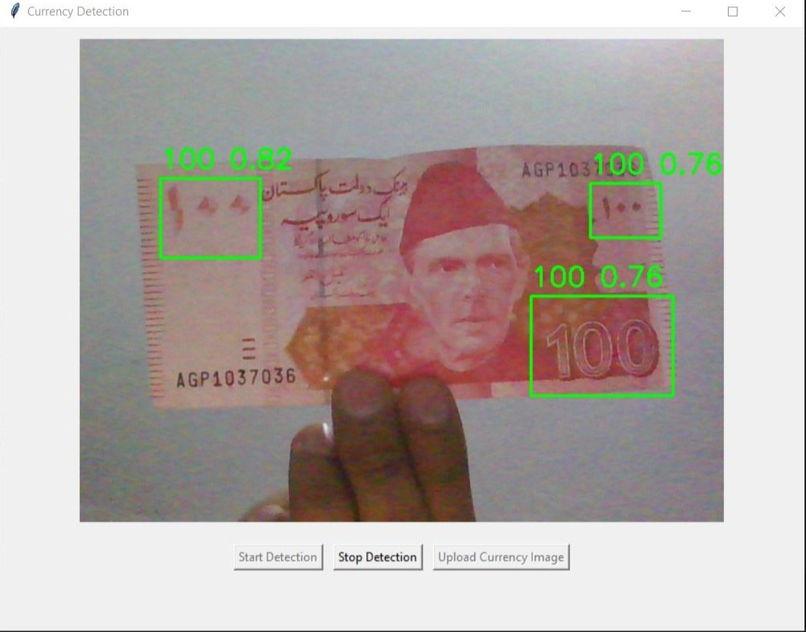
Testing model on currency note

Slide 17
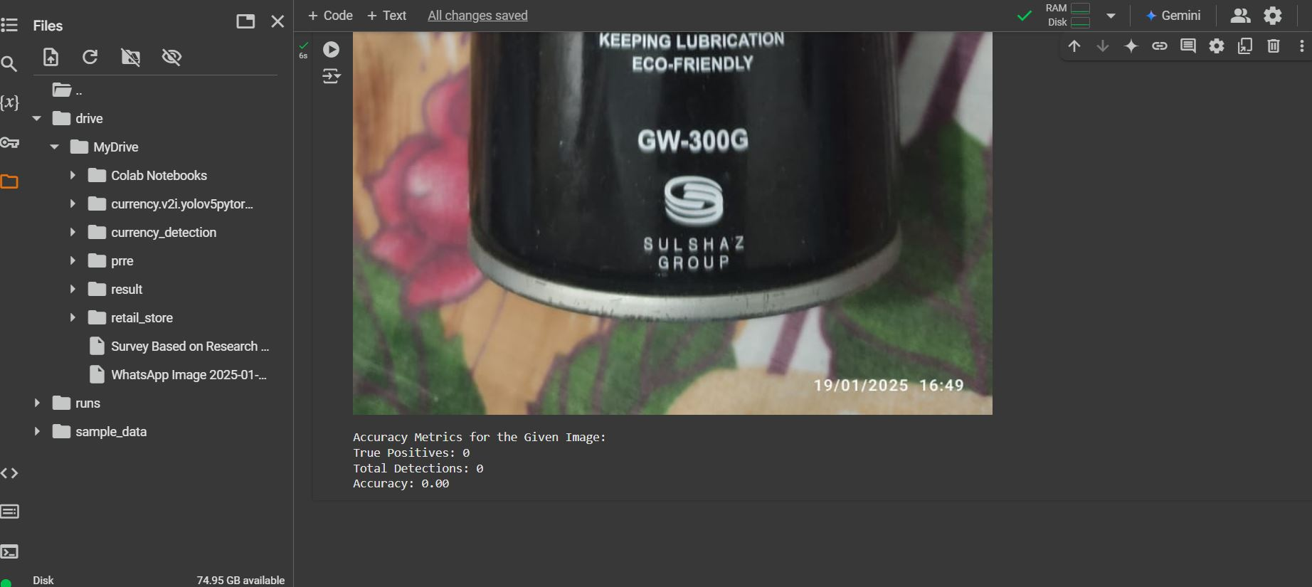
Testing model on random image

Slide 18
Future work
This project has great potential for future enhancements and the incorporation of additional features. One possible extension is the capability to detect currency coins in addition to banknotes, including any newly issued currency. Another promising direction is to develop a cross-platform version of the application compatible with iOS & android devices, thereby increasing accessibility and expanding the user base.

Slide 19
Thanks

